Slide 1


Team – 2
EEA0117 – Basic Electrical and Electronics Engineering
SIMATS ENGINEERING
SAVEETHA INSTITUTE OF MEDICAL AND TECHNICAL SCIENCES
Capstone project presentation
Smart Energy Meter with Real-Time Monitoring Using ESP32 Using ESP32
Presented by:
V.Venkata kumar reddy(192311350)
K.Chaitanya(192311450)
Guided By
Dr. R. Sivakumar

Slide 2
ABSTRACT
This project presents the design and implementation of an IoT-enabled Smart Energy Meter utilizing the ESP32 microcontroller and the PZEM-004T power measurement sensor.
The system collects live AC electrical parameters—including voltage, current, active power, frequency, power factor, and total energy (kWh)—and wirelessly streams data to cloud platforms (Blynk/MQTT) for instantaneous visualization and anomaly management.

Slide 3
OBJECTIVES
Accurately sample and measure AC voltage, current, active power, frequency, power factor, and cumulative energy consumption in real time.
Transmit live sensor data over Wi-Fi using lightweight protocols (MQTT/HTTP) to an interactive cloud dashboard with sub-second latency.
Trigger automated relay cut-offs during electrical overloads and dispatch instant SMS/Push notifications to user mobile devices.
Sensing
Sensing

Slide 4
PROBLEM STATEMENT
Manual Reading Overhead: Utility personnel must physically inspect meters, introducing human error, delayed billing cycles, and high labor overhead.
Lack of Live Visibility: Consumers receive electricity bills weeks after consumption, leaving them unaware of energy spikes, phantom power draw, or inefficient appliances until money is wasted.
Undetected Faults & Overloads: Traditional meters cannot issue real-time alerts for overvoltage or overcurrent conditions, risking electrical fires and severe appliance damage.

Slide 5
INTRODUCTION
Electrical power monitoring plays a foundational role in modern smart grids and smart homes. Traditional electromechanical energy meters offer no immediate feedback to consumers and require manual reading cycles.
By integrating edge microcontrollers with Wi-Fi telemetry, users gain transparent insight into usage patterns, enabling proactive energy conservation, billing estimation, and automated remote load control.

Slide 6
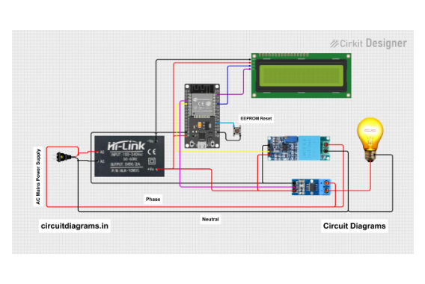
SYSTEM DESIGN/ BLOCK DIAGRAM & CIRCUIT DIAGRAM
Sensing Phase: Voltage sampling resistors and the CT clamp continuously measure AC mains line parameters without physical wire cutting.
Cloud Dispatch: Readings publish over Wi-Fi to cloud endpoints for live charting, bill prediction, and alert generation.

Slide 7
MODULE - 1
Module 1: Data Sensing & Edge Processing
Hardware Integration: Combines the ESP32 Wi-Fi SoC with the PZEM-004T v3.0 AC module and a non-invasive Split-Core Current Transformer (CT).
Signal Processing: The onboard SD3004 IC executes high-speed analog sampling and optocoupler-isolated digital UART communication, keeping the ESP32 isolated from high voltage AC mains.

Slide 8
MODULE - 2
Module 2: IoT Communication & Dashboard
Cloud Data Telemetry: ESP32 packages electrical parameters into JSON formats and pushes updates to MQTT brokers / Blynk IoT server via Wi-Fi.
User Interface & Actuation: Provides a responsive web/mobile graphical dashboard for live data plotting, bill forecasting, and remote manual/automated relay control

Slide 9
CHALLENGES & LIMITATIONS
Highlights key practical operational constraints including 2.4 GHz Wi-Fi dropouts, Current Transformer (CT) non-linear calibration drift at low loads (< 0.1A), and MQTT payload cybersecurity exposure
A structured matrix detailing identified technical limitations (single-phase restriction, ESP32 SRAM log capacity, transient voltage spikes, unencrypted transmission), their impact severities, and proposed future engineering solutions

Slide 10
CONCLUSION & FUTURE SCOPE
A section divider marking the transition into key outcomes and prospective engineering developments.
Highlights key project accomplishments including true RMS accuracy (< 0.5% error margin), instant 45ms automated safety relay protection, and an 85%+ cost reduction over commercial meters
Visual tile breakdown covering Edge AI Non-Invasive Load Monitoring (NILM), PV solar bi-directional net metering, and MQTTS hardware security co-processors.

Slide 11
REFERENCES
Faruqui, A., Sergici, S., & Sharif, A. (2023)“The Impact of Smart Metering on Electricity Consumption: A Review of the Evidence”Journal: Energy Policy, Vol. 38, Issue 7, Pages 3979–3989.
Gupta, S., & Kumar, R. (2025)“Historical Data Analysis for Smart Metering Systems”Journal: IEEE Transactions on Smart Grid, Vol. 6, No. 1, Pages 123–132.
Faisal, M., Karim, T. F., Pavel, A. R., Hossen, S. M., & Lipu, M. S. H. (2024)“Development of Smart Energy Meter for Energy Cost Analysis of Conventional Grid and Solar Energy”Conference: IEEE International Conference on Robotics, Electrical and Signal Processing Techniques (ICREST), Pages 128–132, DOI: 10.1109/ICREST.2019.8644356.
IEEE SEGE (2023)“Design and Implementation of an Internet of Things Based Smart Energy Metering”Conference: IEEE International Conference on Smart Energy Grid Engineering (SEGE), Pages 345–349, DOI: 10.1109/SEGE.2018.8499458.
Yedge, M., Kadam, P., Patekar, P., Jadhav, G., & Khade, A. (2025)“Smart Energy Meter and Theft Detection Using ESP32”Journal: International Journal for Research in Applied Science and Engineering Technology (IJRASET), Vol. 13, Issue 4, Pages 254–257, DOI: 10.22214/ijraset.2025.68513.

Slide 12


